Slide 1

Rockbuster Stealth Data Insights- Data-Driven Insights for Strategic Decision-Making
Shikha Kamboj

Slide 2
Outline
Introduction
Data Overview
Business Questions and Analysis
Key Recommendations
Conclusion
Q&A
Tableau Link

Slide 3
Introduction
Facing Competition: Rockbuster Stealth aims to transition from physical rentals to an online platform to compete with streaming giants like Netflix and Amazon Prime.
Objective: Support the launch strategy of the new online video service with data-driven insights.
Focus Areas: Customer geography, revenue trends, and sales performance.

Slide 4
Data Overview
Inventory Analysis
Rockbuster currently provides a collection of 1,000 films, all in English, spanning 17 different categories and available in 109 countries.
Minimum
Rental Rate: $0.99
Rental Duration: 3 days
Film Length: 46 min
Replacement Cost: $9.99
Maximum
Rental Rate: $4.99
Rental Duration: 7 days
Film Length: 185 min
Replacement Cost: $29.99
Average
Rental Rate: $2.98
Rental Duration: 5 days
Film Length: 115.3 min
Replacement Cost: $19.98

Slide 5
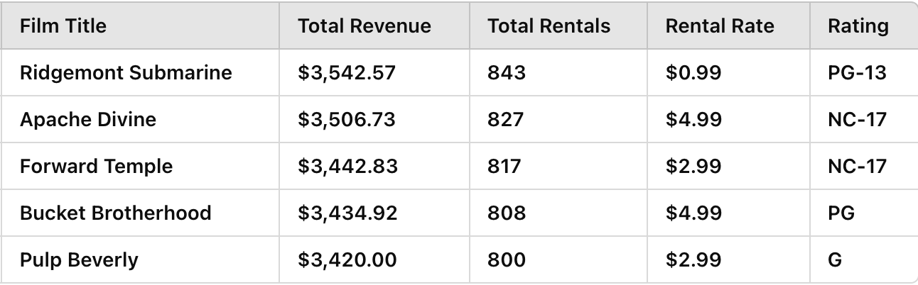
Top 5 performing Films(by total Revenue)

Slide 6
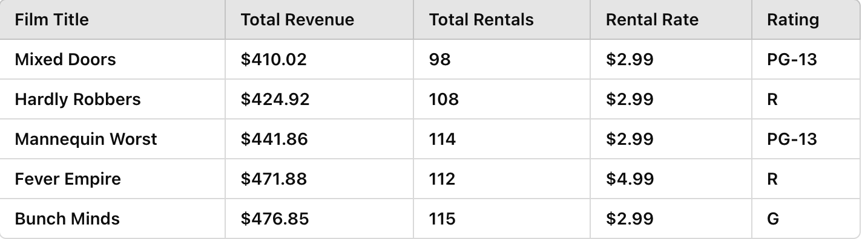
Worst 5 performing Films (by total Revenue)

Slide 7
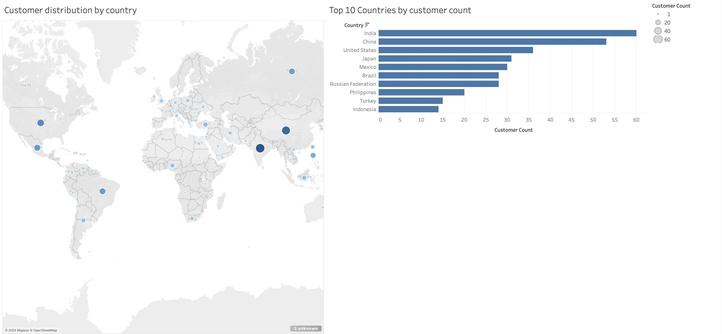
India has the largest customer base, followed closely by China and the United States and the left map displays customer distribution globally, with bubble size indicating the number of customers in each country.

Slide 8
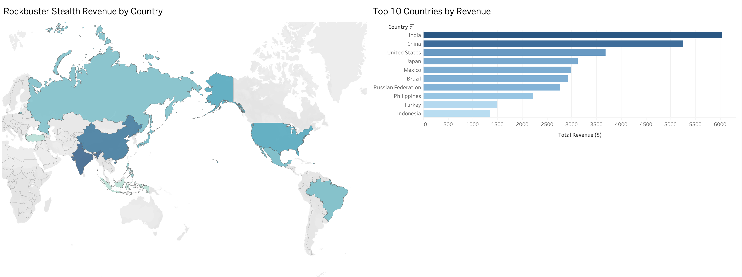
India has emerged as the leading revenue contributor for Rockbuster Stealth, generating a total revenue of $6,034.78. China follows closely with $5,251.03, while the United States ranks third with a total revenue of $3,685.31.

Slide 9
Business Questions and Analysis
The Rockbuster Stealth Management Board has requested data-driven insights to guide their 2020 company strategy. They are seeking answers to several critical business questions to drive decisions about the new online video service launch.
Which movies contributed most/least to revenue?
What’s the average rental duration for all videos?
Which countries are Rockbuster customers based in?
Where are high lifetime value customers located?
Do sales figures vary by region?

Slide 10
Recommendations
Inventory Optimization: Remove low-performing titles and focus on high-demand genres.
Geographic Focus: Launch digital services in India, China, and the United States.
Customer Loyalty Programs: Build exclusive offers for top customers.
Content Strategy: Prioritize top-performing movie categories.

Slide 11
Conclusion
Key Takeaways:
Geographic and customer insights reveal key focus areas.
High-performing films and customers drive revenue growth.
Inventory and pricing strategies need optimization.
Final Thoughts: Rockbuster Stealth is well-positioned to compete in the digital streaming market.

